Slide 1
Logistic Regression
Beyza Ecem Erce

Slide 2
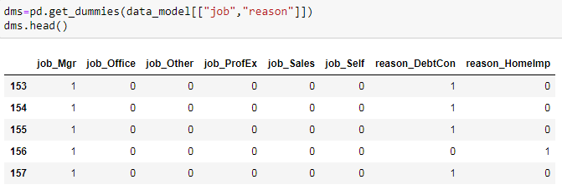
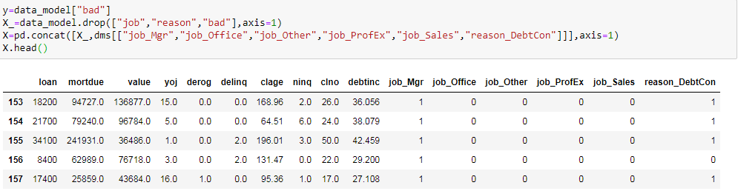
Dummy Variables

Slide 3
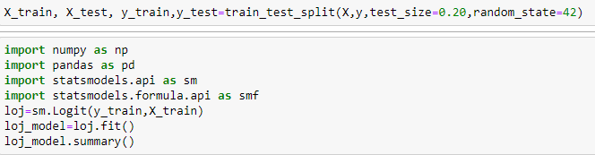
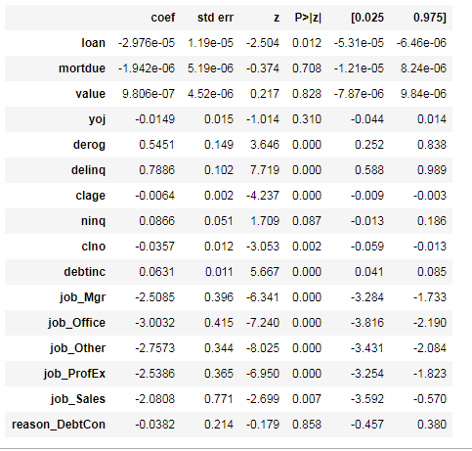
Model (statsmodels)

Slide 4
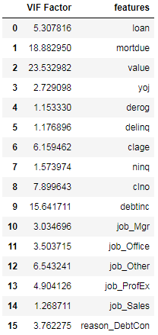
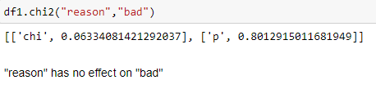
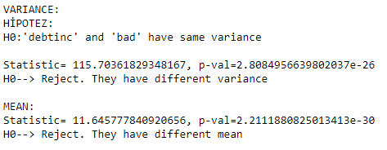
Variable Elimination
“mortdue”, “value”, “yoj”, “ninq”, “reason-Debtcon”→ pvalue>0.05
Reminding:
“debtinc” will be included because of it has effect on “bad”

Slide 5
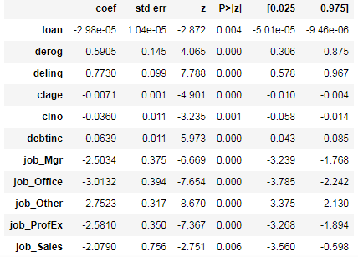
After Elimination…

Slide 6

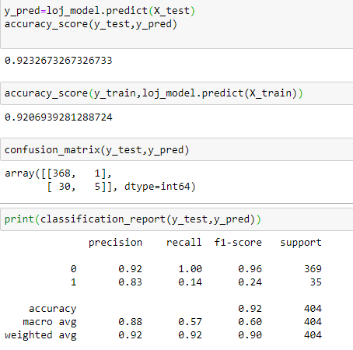
Model2(sklearn)
Note: X_train is includes variables that are at result of previous model

Slide 7
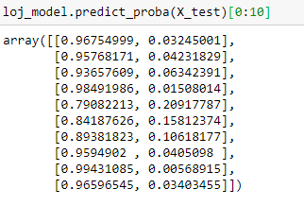
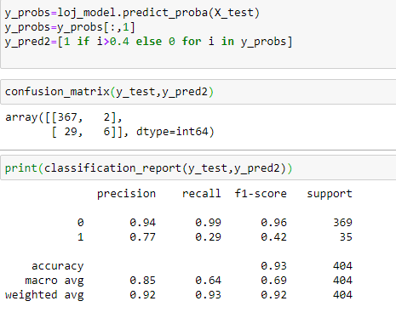
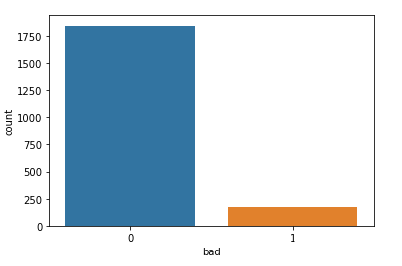
Changing Threshold
Reminding:

Slide 8
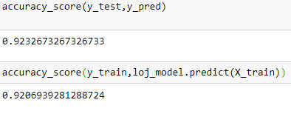
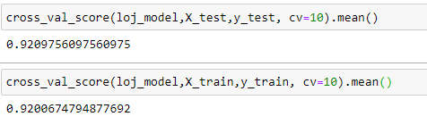
Cross-validation

Slide 9
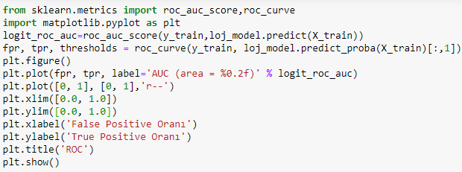
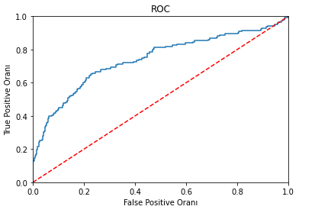

ROC Curve
If we take first 20% of data, we can obtain ≈ 60% costumers who have bad=1.
If we take first 40% of data, we can obtain ≈ 75% costumers who have bad=1.

